Slide 1
EXPLORATORY DATA ANALYSIS
Retail Analytics
Through Python
A complete EDA journey across customer, product,
pricing, fulfillment and return behavior.
Pandas • NumPy • Matplotlib • Seaborn
01

Slide 2
Executive Snapshot
The project applies a complete EDA workflow to 100,000 retail transactions.
ROWS
COLUMNS
RETURN RATE
AVG. FINAL PRICE
100,000
18
14.8%
₹64,165.72
transactions
features
14,811 returns
median ₹49,752.39
• Zero missing values across all 18 columns.
• Zero exact duplicate rows; customer IDs are unique.
• Final price is right-skewed and contains a small high-value tail.
• EDA covers univariate, bivariate, multivariate, correlation, outliers, skewness and kurtosis.
02

Slide 3
1 | Dataset Structure & Data Types
The notebook confirms a complete 18-column retail transaction table.
ROWS
MEMORY
NUMERIC
STRING
100,000
13.7 MB
6
12
RangeIndex 0–99,999
DataFrame footprint
5 int + 1 float
Customer/product/etc.
• Customer: customer_id, age, gender, city, state, customer_segment
• Order: order_id, order_date
• Product: category, subcategory, product_price, quantity
• Commercial: discount_percentage, final_price
• Fulfillment: payment_method, shipping_type, delivery_days, return_status
NUMERIC DATA TYPES
• int64: age, product_price, quantity, discount_percentage, delivery_days
• float64: final_price
SOURCE CHECK
All 18 fields report 100,000 non-null observations.
03

Slide 4
2 | Data Quality Validation
The notebook performs structural checks before statistical interpretation.
MISSING VALUES
EXACT DUPLICATES
DUPLICATE CUSTOMER IDS
ROWS RETAINED
0
0
0
100%
• df.info() confirms 100,000 non-null records for every column.
• df.isnull().sum() returns zero for every feature.
• Duplicate-row check returns no exact duplicates.
• Customer-ID uniqueness check returns no duplicates.
• Descriptive statistics are then computed for core numerical fields.
04

Slide 5
3 | Full Numerical Statistical Summary
The notebook reports count, mean, median, standard deviation, min, max, skewness and kurtosis.
Metric
Mean
Median
Std
Min
Max
Skew
Kurtosis
Metric
Mean
Median
Std
Min
Max
Skew
Kurtosis
Product price
30,164.53
30,148.00
17,139.68
500
59,998
0.00
−1.20
Discount %
15.01
15.00
8.95
0
30
−0.00
−1.20
Final price
64,165.72
49,752.39
49,969.28
357
239,980
0.93
0.17
Quantity
2.50
3.00
1.12
1
4
−0.00
−1.36
The key distribution signal is final_price: its mean is well above its median, with skewness 0.93.
05

Slide 6
4 | Categorical Distribution — Customer & Gender
The notebook checks customer segment, gender, payment, shipping and return-status composition.
NEW SEGMENT
REGULAR
PREMIUM
CREDIT CARD
33,488
33,361
33,151
25,307
33.5%
33.4%
33.2%
largest payment method
• Payment: Credit Card 25,307; UPI 25,139; COD 24,994; Debit Card 24,560.
• Customer segment is nearly evenly split across New, Regular and Premium.
• The notebook also plots gender and shipping type distributions as part of categorical univariate analysis.
CATEGORICAL COVERAGE
• Gender
• Customer segment
• Product category
• Payment method
• Return status
• Shipping type
06

Slide 7
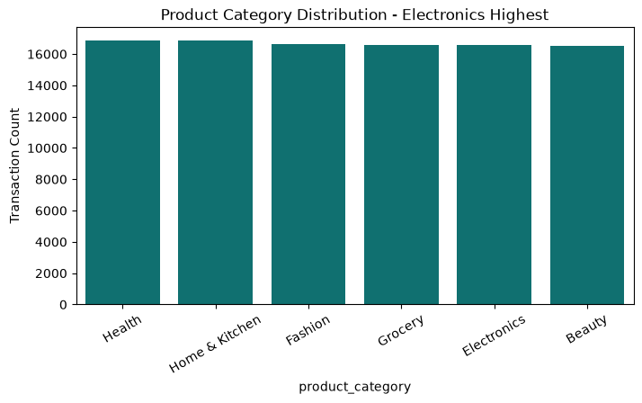
5 | Product Category Distribution
The notebook prints category counts and visualizes the transaction mix.
PRINTED COUNTS
Health
16,858
Home & Kitchen
16,848
Fashion
16,613
Grocery
16,592
Electronics
16,576
Beauty
16,513
Important source note:
The notebook's chart title/print label says “Electronics highest,” but the printed counts show Health (16,858) is highest.
07

Slide 8
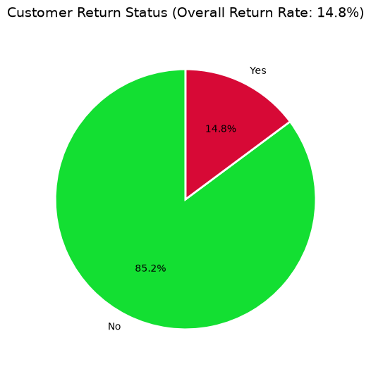
6 | Returns — The Core Customer Outcome
The notebook quantifies both counts and percentages.
RETURNED
NOT RETURNED
14,811
85,189
14.811%
85.189%
WHAT THE NOTEBOOK DOES WITH RETURNS
• Compares product category against return rate.
• Compares delivery days against return status.
• Tests shipping type alongside delivery behavior.
• Uses return status again in multivariate analysis.
08

Slide 9
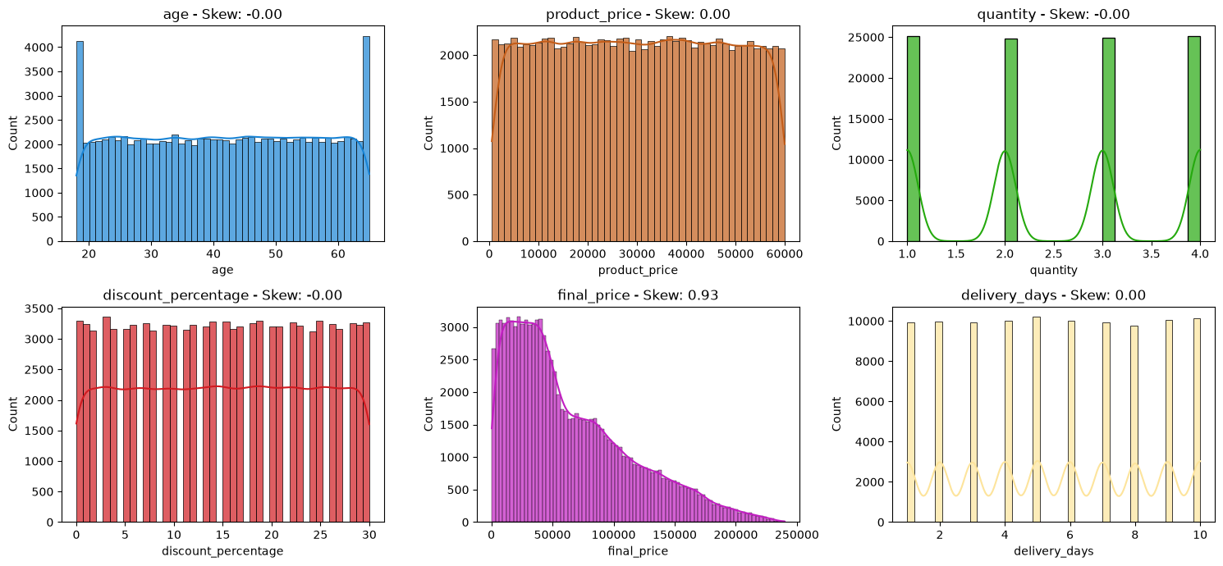
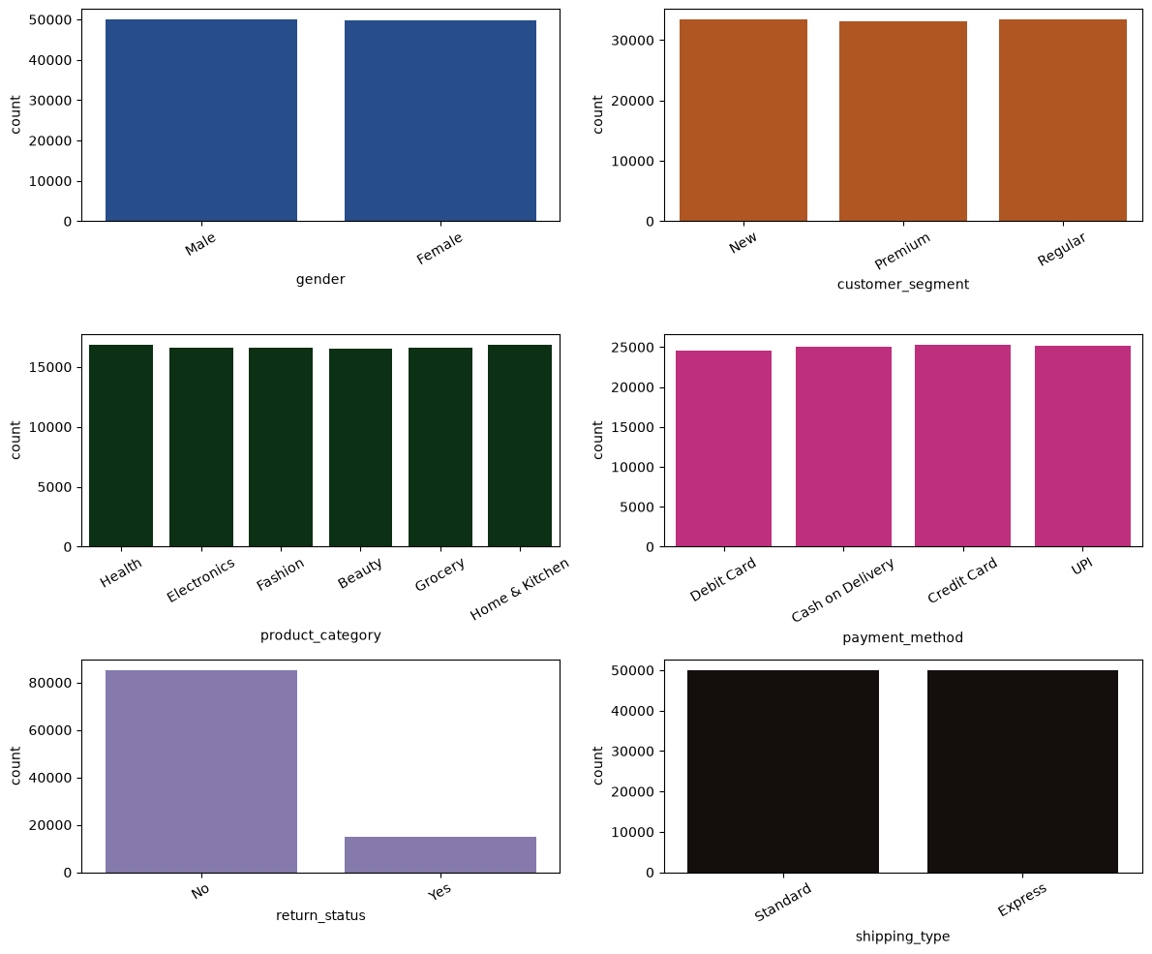
7 | Univariate Distributions
Histograms + KDE are generated for all numerical variables; countplots cover six categorical variables.
Numerical plots annotate skewness; final_price shows the strongest positive skew.
Categorical plots cover gender, segment, category, payment, returns and shipping.
09

Slide 10
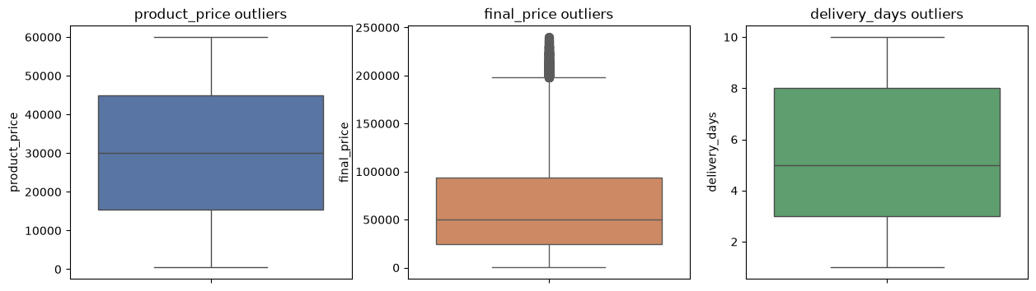
8 | Outlier Detection — Two Methods
The notebook uses both IQR and Z-score methods and interprets high-value observations as potentially valid.
IQR OUTLIERS
Z-SCORE > 3
1,335
503
1.33%
extreme cases
• High quantity + Premium category can explain high final prices.
• Notebook explicitly says these should not be removed immediately.
• Example records above ₹20,000 include legitimate high-value orders.
10

Slide 11
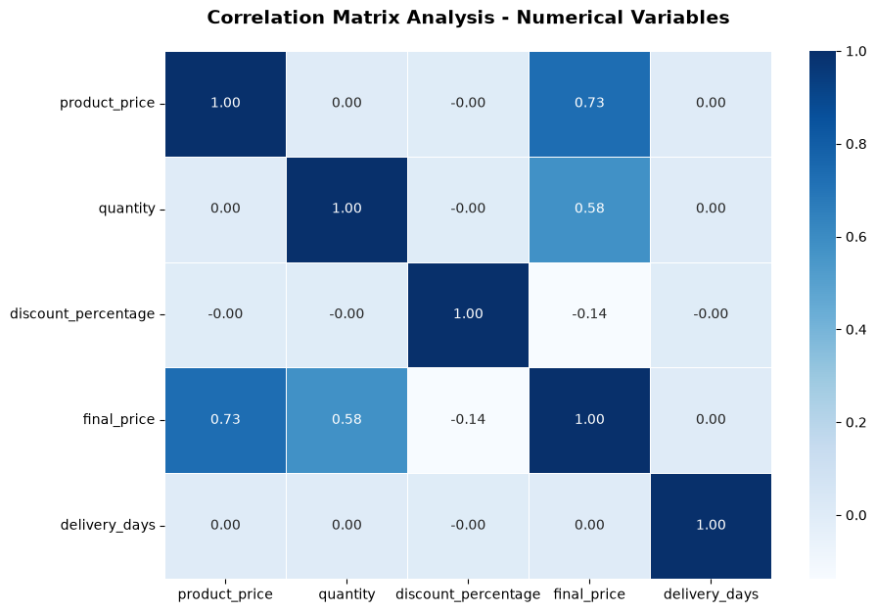
9 | Pearson Correlation Matrix
The full matrix shows how numerical variables relate to final_price and to each other.
Product price
0.730757
Quantity
0.575303
Discount
−0.137332
Delivery days
0.003789
Age
−0.000823
Notebook interpretation:
product_price and quantity are the strongest positive relationships with final_price.
11

Slide 12
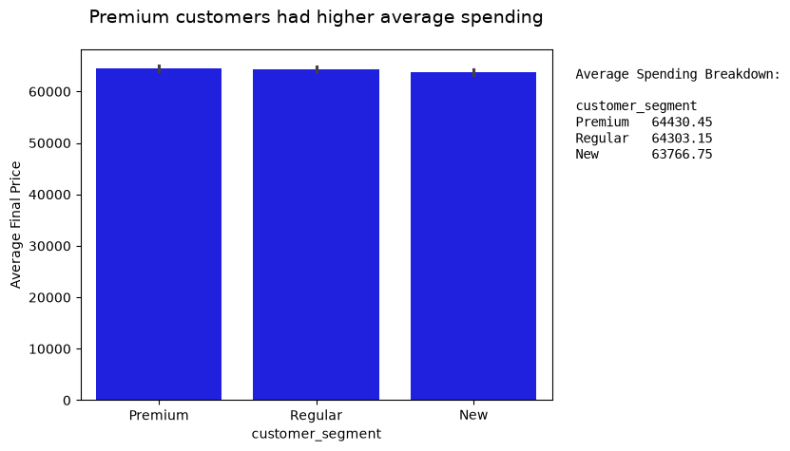
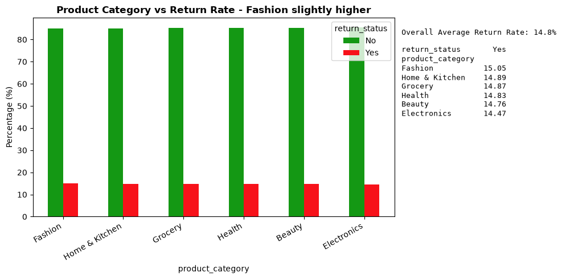
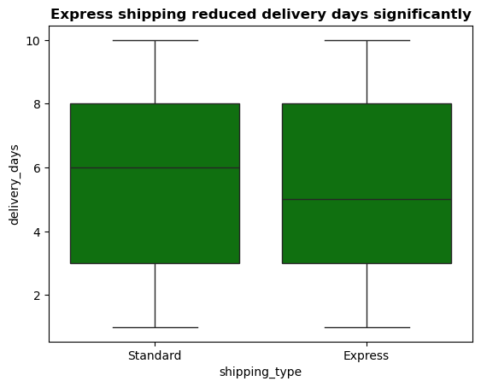
10 | Numerical vs Categorical Analysis
Average spending, category return rates and shipping performance are compared directly.
Customer segment
Premium is described as higher average spending.
Category vs returns
Fashion is described as slightly higher.
Shipping
Express mean 5.497 days; Standard 5.514 days.
12

Slide 13
11 | Shipping & Delivery — Exact Statistics
The notebook reports mean, median, minimum and maximum delivery days by shipping type.
Shipping
Mean
Median
Min
Max
Express
5.4974
5
1
10
Standard
5.5137
6
1
10
The notebook’s chart title states that Express shipping reduced delivery days significantly, while the printed means differ only slightly.
RETURN STATUS × DELIVERY DAYS
NO RETURN
RETURNED
Difference is very small:
≈ 0.0042 day.
5.5049 days
5.5091 days
mean delivery time
mean delivery time
13

Slide 14
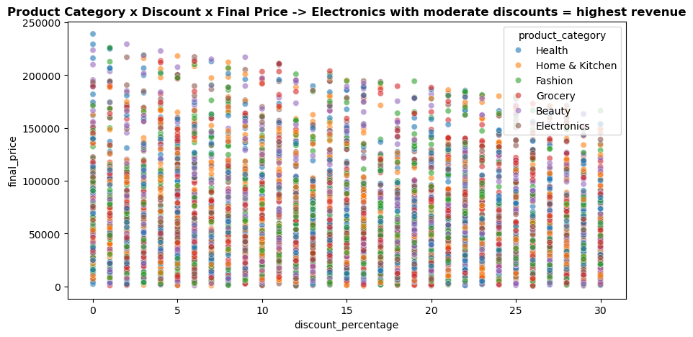
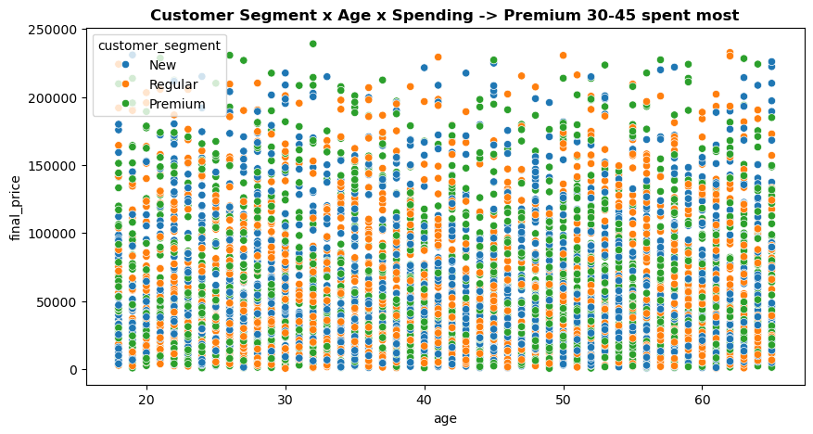
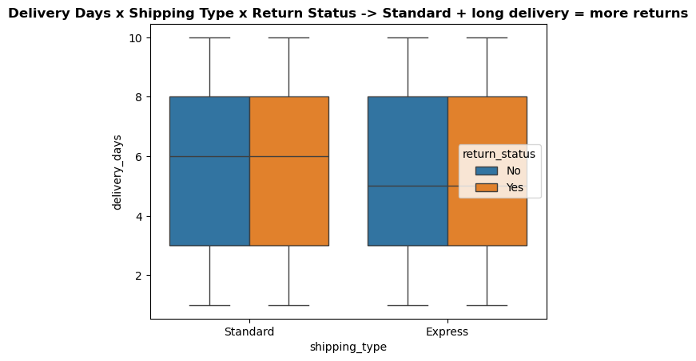
12 | Multivariate Analysis
The notebook combines three dimensions to inspect interactions.
Category × Discount × Final Price
Segment × Age × Spending
Delivery × Shipping × Returns
• Notebook labels: Electronics + moderate discounts = highest revenue; Premium 30–45 = highest spending; Standard + long delivery = more returns.
14

Slide 15
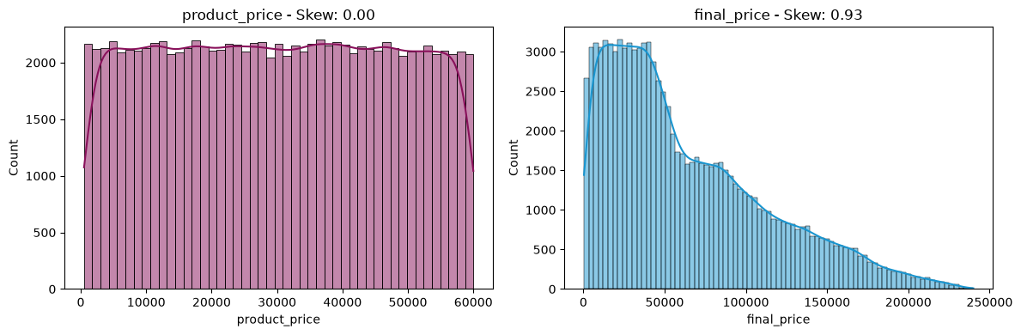
13 | Skewness & Kurtosis
The notebook explicitly measures distribution shape, not just averages.
FINAL PRICE SKEW
FINAL PRICE KURTOSIS
0.93
0.17
right-skewed
near zero
• Product price: skew 0.00, kurtosis −1.20
• Quantity: skew −0.00, kurtosis −1.36
• Discount: skew −0.00, kurtosis −1.20
The final-price distribution is the clearest departure from symmetry.
15

Slide 16
14 | Key Statistical Findings
The notebook adds several findings beyond the basic EDA charts.
TOP 10% REVENUE SHARE
PREMIUM PURCHASES
MEAN VS MEDIAN
26.4%
5,000
64,165.72 > 49,752.39
highest-value transactions
>95th percentile
evidence of right skew
DISCOUNT-BAND SPENDING
RETURN / DELIVERY FINDING
• 0–10%: ₹71,910.36 average final price
• 10–20%: ₹63,853.35
• 20–30%: ₹55,980.75
• No-return mean delivery: 5.5049 days
• Returned mean delivery: 5.5091 days
• Notebook describes the difference as a slight increase with longer delivery.
Important: these are findings reported/generated by the notebook; correlation and descriptive patterns do not by themselves establish causation.
16

Slide 17
15 | What the Project Successfully Applies
The conclusion section of the notebook explicitly lists the analytical methods used.
Univariate
Bivariate
Multivariate
statistical analysis
relationship analysis
interaction analysis
Correlation
Outliers
Skewness & Kurtosis
study
detection
measurement
Notebook conclusion: the analysis provides a strong foundation for predictive modeling and business decision-making.
Core libraries: Pandas • NumPy • Matplotlib • Seaborn
17

Slide 18
PROJECT CONCLUSION
From raw transactions
to evidence.
A structured EDA workflow turns a 100K-row retail dataset into measurable insights about pricing, customers, fulfillment and returns.
CLEAN DATA
STATISTICS
RELATIONSHIPS
THANK YOU
OUTLIERS
INSIGHTS
Questions & Discussion
18

